Slide 1
CREDIT CARD FRAUD DETECTION 3-Layer NEURAL NETWORK vs ANOMALY DETECTION
HARSH BANSAL
AI Technology and Systems

Slide 2
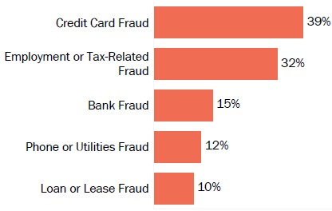
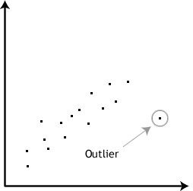
Problem Description
Credit card fraud is a wide-ranging term for theft and fraud committed using or involving a payment card, such as a credit card or debit card, as a fraudulent source of funds in a transaction. The purpose may be to obtain goods without paying, or to obtain unauthorized funds from an account. Credit card fraud is also an adjunct to identity theft. According to the United States Federal Trade Commission, while the rate of identity theft had been holding steady during the mid-2000s, it increased by 21 percent in 2008. However, credit card fraud, that crime which most people associate with ID theft, decreased as a percentage of all ID theft complaints for the sixth year in a row. Although incidences of credit card fraud are limited to about 0.1% of all card transactions, they have resulted in huge financial losses as the fraudulent transactions have been large value transactions.

Slide 3
Proposed Solution
So, this project aim to find the best algorithms to detect the outliers or frauds by analyzing the given data. This can be achieved if train a model on a provided dataset using different algorithms. The algorithms we will be using are –
3-Layer Neural Network
Anomaly Detection Algorithms( Isolation Forest, OneClassSVM, Local Outlier Factor, DBSCAN)
Self Organizing Maps (Unsupervised Learning )
Algorithm will be analyzed based on factors like:
Accuracy Score( Precision And Recall also been considered)
Time Complexity
Space Complexity
Algorithm satisfying all these factors will be best suited for our purpose. There also some trade off between these factors as we will focus more on accuracy.

Slide 4
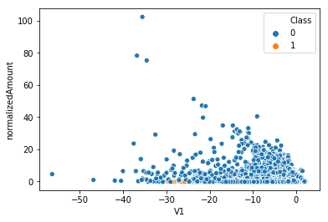
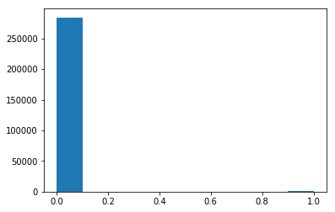
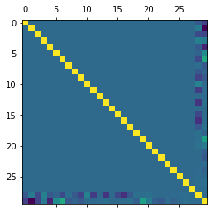
Dataset used
For this purpose, we have been provided a dataset. The datasets contain transactions made by credit cards in September 2013 by European cardholders. This dataset presents transactions that occurred in two days, where we have 492 frauds out of 284,807 transactions. The dataset is highly unbalanced, the positive class (frauds) account for 0.172% of all transactions. It contains only numerical input variables which are the result of a PCA transformation. Unfortunately, due to confidentiality issues, we cannot provide the original features and more background information about the data. Features V1, V2, ... V28 are the principal components obtained with PCA, the only features which have not been transformed with PCA are 'Time' and 'Amount'. Feature 'Time' contains the seconds elapsed between each transaction and the first transaction in the dataset. The feature 'Amount' is the transaction Amount, this feature can be used for example-dependent cost sensitive learning. Feature 'Class' is the response variable and it takes value 1 in case of fraud and 0 otherwise.

Slide 5
Benefits and Impact
As we have already mentioned credit card fraud has been growing rapidly as well as the world of artificial intelligence also. So with the help of machine learning we can build a robust model which can help us to detect the outliers or frauds with a very impressive accuracy. So this model can help to prevent the credit card fraud and loss of capital because of this. Since it is not possible to completely eradicate the credit cards fraud but still, we can find the culprits and punish them which can downsize this fraud.

Slide 6
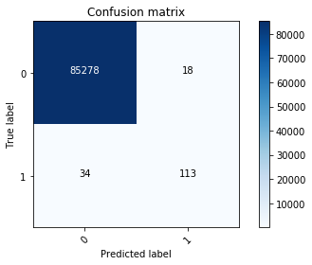

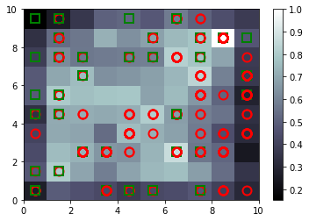
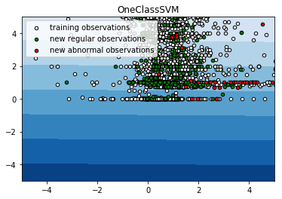
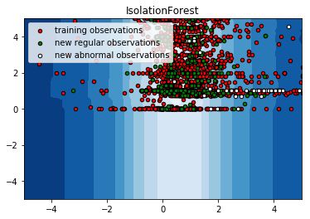
Solution Discussion
As according to our approach we train our model using mentioned algorithms and predict the outliers. Each algorithms have its own accuracy and complexity.
Neural Network- It predict the outliers with accuracy of 99% in time of 6 min
Isolation Forest- Accuracy on detecting outlier is 90% in time 1 min
OneClassSVM- It predict the outliers with accuracy of 91% in time of 35 min
Local Outlier Factor- Accuracy is 90 % in time of 35 min
DBSCAN- Its accuracy is 99% but not predicting the outliers

Slide 7
Challenges
We must face some challenges while building model for the purpose. As to find an algorithm fulfilling all our requirements is quite difficult. Like some of algorithms like Isolation Forest and DBSCAN are providing best time complexity but not the accuracy. And algorithms like OneClassSVM and Local Outlier Factor are providing decent accuracy but taking much time for training. So we have trade off between these factors to get an algorithms taking decent time and providing satisfactory accuracy. After analyzing, Neural Network has provided us best accuracy of 99% and a decent time complexity

Slide 8
Results
Several algorithms have been implemented on same data set to detect the credit cards frauds. All the algorithms have been analyzed and compared on basis of factors we have chosen. We implemented different type of algorithms which include neural network from deep learning, anomaly detection algorithms like isolation forest, OneClassSVM, Local Outlier Factor, supervised algorithm like DBSCAN and unsupervised algorithm like Self-Organizing Maps. This was done to attain the best approach for the purpose. Upon analyzing we conclude that 3-Layer Neural Network have been the best algorithms for the purpose of credit card fraud detection as it provides best accuracy with best precision and recall on both cases. It was also decent in case of time complexity and space complexity but not the best compared to isolation forest and DBSCAN. But accuracy is best of all. It gives 99% accuracy which close to perfect. DBSCAN algorithm is also providing the 99% accuracy but its precision and recall are zero for fraud case which is not acceptable. In future this type of algorithm can be used in different cases.

Slide 9
Future work
Since this project is trained on a dataset which contains around 300,000 records. But the amount of data we want to train is very in real world scenario.
Also in case of neural network the time complexity can also be improved by using more powerful system. The work on algorithms like DBSCAN can also be improved as it is also providing an accuracy of 99% and in very less time as compared to neural network but lacks on evaluation. Anomaly Detection algorithms can also be improved in this case as some of them showing good accuracy but poor time complexity and vice-versa.

Slide 10
Summary
So our purpose is to find best algorithm to detect the credit card frauds. We trained models like 3-layer Neural Network and anomaly detection algorithms. These algorithms are trained on a dataset which contains records of 300,000 customers transactions. We must decide the best algorithm for the purpose. These algorithms are to be compared on factors like accuracy achieved, time and space complexity. So we perform required data processing, cleaning and visualization of each algorithms, trained the model and receive the required statistics of each algorithm. Upon analyzing we come to a conclusion that 3-Layer Neural Network is best suited algorithm for the purpose as it is providing accuracy of 99% with decent time of 6 min. Other algorithms have some flaws like some are providing good accuracy but poor time complexity and vice-versa.

Slide 11


